Slide 1
Consumer Response to Divine Associations in Brands CBR 2015 - Porto
Valentina Nedeva, Sandor Czellar, Felicitas Morhart
contact: valentina.nedeva@unil.ch

Slide 2
Brand Models
2015
2010
Cultural
2000
Viral
1990
Emotional
1970
Mind Share
Holt (2002, 2004)

Slide 3
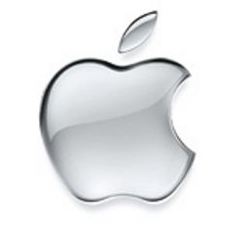
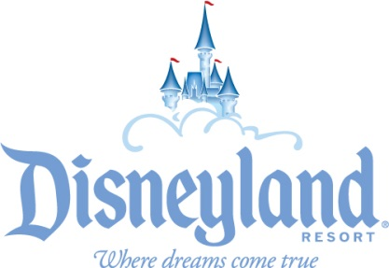
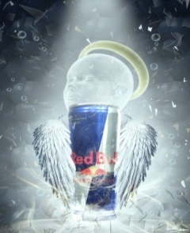
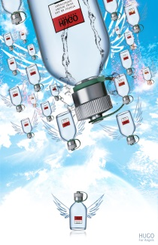
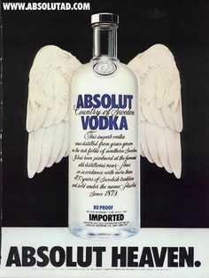
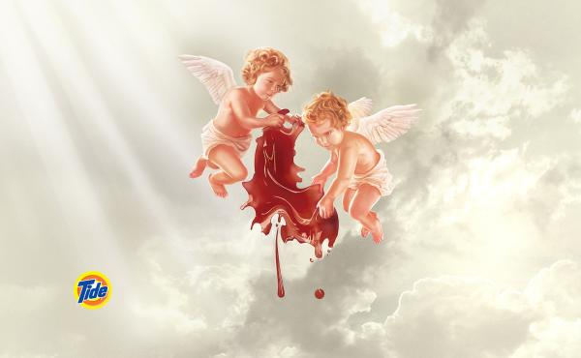
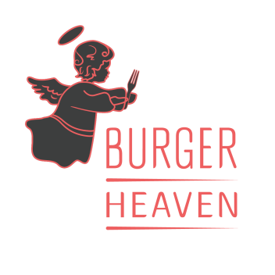
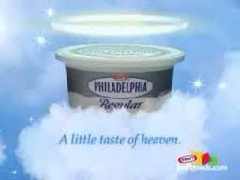
Evidence
Consumers tend to sacralise objects, people, places, experience, times and even brands (Belk et al., 1989; Belk & Tumbat, 2005; Brown in Rinallo et al., 2012; Lyon, 2000; Muniz & Schau, 2005; Rinallo et al., 2012; Schouten & McAlexander, 1995; Schouten et al., 2007)
Brands use religious elements in their communication (Maddock & Fulton, 1996; Moore, 2005; Twitchell, 2007)

Slide 4
Branding Opportunities
Market potential:
Estimation that 84% of the 2010 world population religiously affiliated (Pew Research Center’s Forum on Religion & Public Life, 2012)
Most of the 16% not affiliated with any religion claim to be spiritual or believe in a god (Pew Research Center’s Forum on Religion & Public Life, 2012)
Institutionalization of religion & cultural fragmentation of societies (Palazzo & Basu, 2007; Pargament, 1999; Swatos, 1983)
Market for transcendence offering open to popular culture & consumption institutions (Atkin, 2004; Belk et al., 1989; Chidester, 2005; Einstein, 2008; Lyon, 2000; Ragas & Bueno, 2002; Rinallo et al., 2012)
→ Divine as a potential component for brand image
Notes:
683 active registered brands using divine in their name (WIPO - Global Brand Database, 2015)

Slide 5
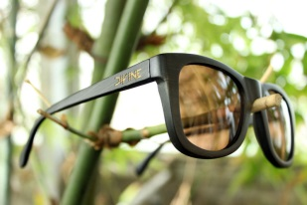
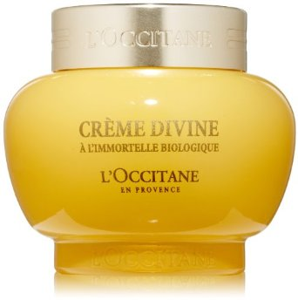
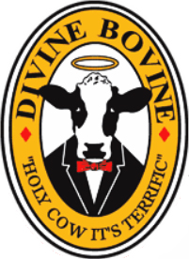
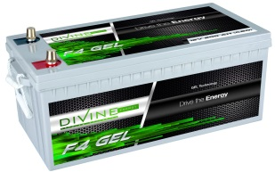
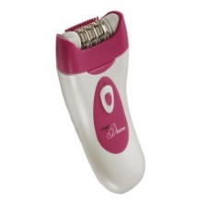
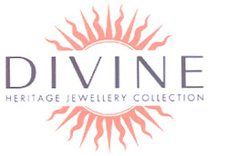
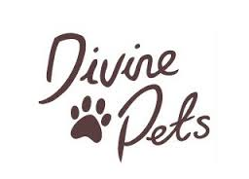
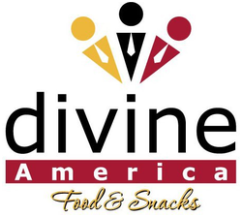
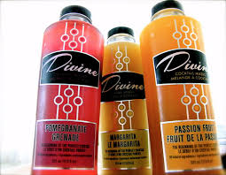
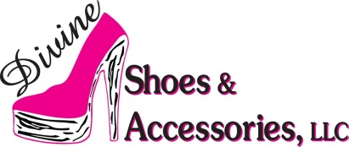
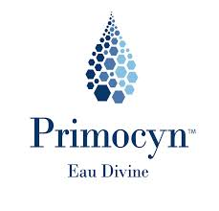
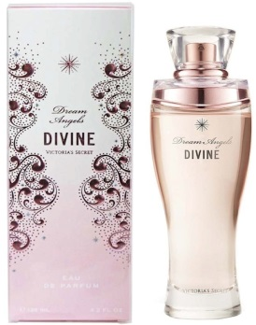
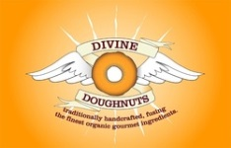
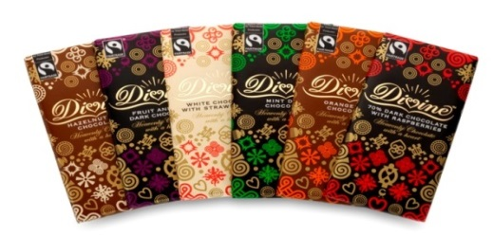
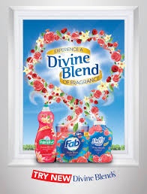
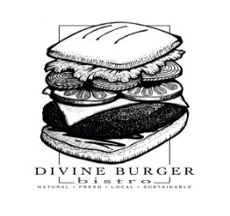
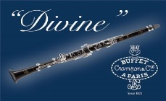
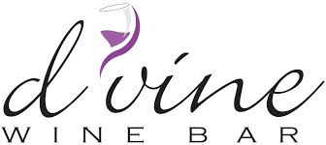
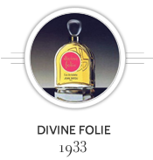
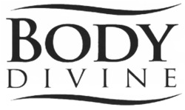
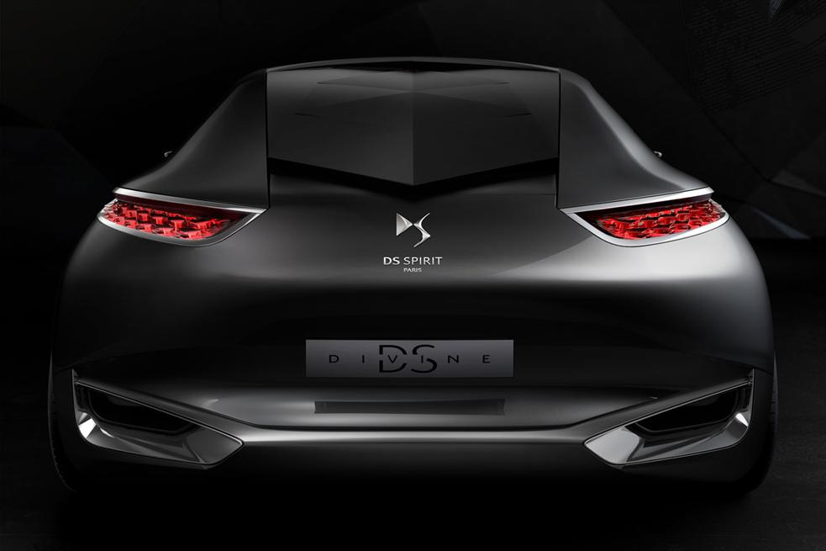
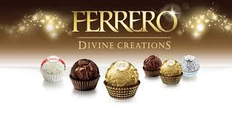
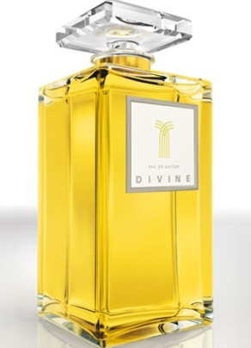
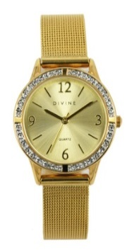
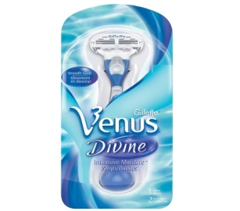
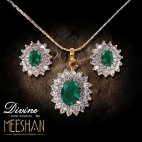

Slide 6
Research Goals
To investigate whether or not brands can legitimately claim to provide benefits for consumers by associating themselves with the divine
To investigate consumer reactions to brands that use divine references in their branding strategy and specifically as part of the brand names
Based on Keller’s (1993) associative network memory model of brands:
What type of brand associations “divine” mentions in brand names form/strengthen in consumer minds
How these associations influence consumer evaluations, preferences & behaviors
Potential individual, brand-related & situational moderators of the effect

Slide 7
Literature Overview
Religion relates to a diverse range of psychological outcomes (Chan et al., 2014; Laurin et al., 2012)
Religious/transcendental primes affect:
self-evaluation concerns (Baldwin et al., 1990)
self-attribution of authorship for events (Djksterhuis et al., 2008)
prosociality (Pichon et al., 2007; Shariff & Norenzayan, 2007)
honesty (Randolph-Seng & Nielsen, 2007)
submissiveness (Saroglou et al., 2009)
attachment–related processes (Birgegard & Granqvist, 2004; Kirkpatrick, 1999)
stress responses (Inzlicht & Tullett, 2010; Weisbuch-Remngton et al., 2005)
humor (Saroglou & Jaspard, 2001)
aggressive behavior (Bushman et al., 2007; Saroglou et al., 2009)

Slide 8
Literature Overview
Brand elements such as:
Brand names (Adaval, 2003; Argo et al., 2010; Garner, 2005; Lerman & Garbarino, 2002; Wänke et al., 2007)
Logo & visual stimuli (Hagtvedt, 2010; Henderson & Cote, 1998; Hutton, 1997; van Riel et al., 2001)
Typeface design (Childers & Jazz, 2002; Doyle & Bottomley, 2006; Henderson et al., 2004)
Product design (Bloch et al., 2003; Bloch, 1995; Cox & Cox, 2002; Hollins & Pugh, 1990)
Packaging (DeBono et al., 2003; Orth & Malkewitz, 2008)
act as cues that retrieve or signal product attributes, benefits, affect, or overall quality and thus influence brand image

Slide 9
Divine Concept
From an associative network perspective, the associations consumers have with the divine concept should affect their brand knowledge, evaluations & behaviors when divine is used as a cue in the brand elements
The Six Divine Attributes (Brower et al., 2009 in The Oxford Handbook of Philosophical Theology)
Self-sufficiency
Omniscience
Eternity
Omnipresence
Omnipotence
Moral perfection

Slide 10
Conceptual Model
Situational Context
Heuristic processing
Systematic processing
Relevant Consumer Knowledge
Extant knowledge about the divine
Brand image congruence
Consumer Attitudes, Preferences & Behaviors
Brand attitudes
Product perception
Self-brand connection
Brand attachment
Brand forgiveness
Brand choice under stress
The Usage of Divine in Brand Names
Activation of Specific Brand Associations
Consumer Characteristics
Salience of religious stereotypes
Transcendental time perspective
Consumer skepticism

Slide 11
Exploratory Study: Consumer Associations with the Divine
Discrete free-word association task, 349 undergraduate students from the University of Lausanne, 1786 associations
Condition I: Divine not preceded by marketing words, 90 unique associations:
Religion (43%)
Positive adjectives (17.5%)
Aesthetic appeal (6.1%)
Spirituality (4.5%)
Food (4.3%)
Perfection (4%)
Mythology (2.8%)
Mystery (2.8%)
Power (2.6%)
Distance (2.2%)
Other (10.2%)
Condition II: Divine preceded by marketing words, 114 unique associations:
Religion (34.2%)
Positive adjectives (18.7%)
Perfection (5.3%)
Aesthetic appeal (4.7%)
Quality (3.7%)
Experience (3.7%)
Food (3.2%)
Mythology (3%)
Status (2.6%)
Spirituality (2.5%)
Other (18.4%)

Slide 12
Exploratory Study: Consumer Associations with the Divine
Discrete free-word association task, online, 380 participants from USA, 2353 associations
Condition I: Divine not preceded by marketing words, 157 unique associations:
Religion (40.7%)
Positive adjectives (19.6%)
Aesthetic appeal (6.3%)
Spirituality (4.4%)
Uniqueness (3.6%)
Food (3.3%)
Power (2.9%)
Taste (2.8%)
Excellence (2.3%)
Emotion (2%)
Other (12.1%)
Condition II: Divine preceded by marketing words, 127 unique associations:
Religion (46%)
Positive adjectives (21%)
Spirituality (4.2%)
Food (3.9%)
Aesthetic appeal (3.9%)
Taste (3%)
Excellence (2.4%)
Status (2.3%)
Perfection (2%)
Other (11.3%)

Slide 13
Exploratory Study: Divine vs. Sublime
Discrete free-word association task, 15 undergraduate students from the University of Lausanne, 140 associations
Divine
(46 unique associations):
Religion (42.3%)
Positive adjectives (22.1%)
Spirituality (10%)
Status (5%)
Positive feeling (4%)
Taste (4%)
Aesthetic appeal (3.6%)
Royalty (2.8%)
Power (2.5%)
Other (3.7%)
Sublime
(52 unique associations):
Positive adjectives (24.3%)
Aesthetic appeal (19%)
Nature (12.5%)
Status (11.9%)
Perfection (8.3%)
Product category (7.3%)
Feminine (6.1%)
Positive feeling (3.5%)
Other (7.1%)

Slide 14
Studies: Relevant Consumer Knowledge & Consumer Characteristics
Study 1: within-subject design, word/brand association task
Stage 1: associations with various concepts, one of which divine
Stage 2 (three weeks later): associations with various brands
Brand selection: five unknown brands, one of which having divine (vs. sublime) in the name
Consumer characteristics: existing scales (Boyd & Zimbardo, 1997; Obermiller & Spangenberg, 1998; Worthington et al., 2003)
Study 2: 3 x 3 between-subject design, brands evaluation task
Brands: 3 (functional vs. hedonic vs. symbolic) x 3 (divine vs. sublime vs. control) unknown existing brands (or product categories)
Evaluation categories: developed from exploratory studies
Consumer characteristics: existing scales (Boyd & Zimbardo, 1997; Obermiller & Spangenberg, 1998; Worthington et al., 2003)

Slide 15
Studies: Situational Context, Consumer Attitudes, Preferences & Behaviors
Study 3: 3 x 3 x 2 between-subject design, brands evaluation task
Brands: 3 (functional vs. hedonic vs. symbolic) x 3 (divine vs. sublime vs. control) unknown existing brands (or product categories)
Information processing mode: task importance manipulation (low vs. high) (Maheswaran & Sternthal, 1990)
Consumer characteristics: existing scales (Boyd & Zimbardo, 1997; Obermiller & Spangenberg, 1998; Worthington et al., 2003)
Projected studies for Fall 2015/Spring 2016:
Perception of product qualities
Brand forgiveness
Self-brand connection
Brand attachment
Brand choice under stress

Slide 16
Research Originality and Implications
On a conceptual level: find out whether brands as commercial entities can(not) provide real consumer benefits, for whom and under what situations, if they use transcendental brand references
On a managerial level: point out which brands and consumer segments, and in what kind of marketing contexts, can(not) benefit from an association with the divine
On a societal level: hopefully provide insights on the frontiers of brands as building blocks of meaning in today’s societies

Slide 17
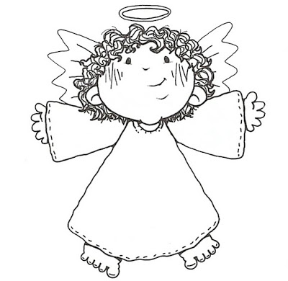
Thank you!

Slide 18
References
Adaval, R. (2003). How good gets better and bad gets worse: Understanding the impact of affect on evaluations of known brands. Journal of Consumer Research, 30 (December), 352-367.
Anderson, J. R. (1983). A spreading activation theory of memory. Journal of Verbal Learning and Verbal Behavior, 22, 261–295.
Argo, J.J., Popa, M., & Smith, M.C. (2010). The sound of brands. Journal of Marketing, 74(4), 97-109.
Atkin, D. (2004). The culting of brands: When customers become true believers. New York: Portfolio.
Belk, R.W. (1987). A child’s Christmas in America: Santa Claus as deity, consumption as religion. Journal of American Culture, 10, 87-100.
Belk, R.W., Wallendorf, M., & Sherry, J. F. Jr. (1989). The sacred and the profane in consumer behavior: Theodicy on the Odyssey. Journal of Consumer Research, 16(June), 1-38.
Belk, R.W., & Tumbat, G. (2005). The cult of Macintosh. Consumption Markets and Culture, 8, 205-218.
Bloch, P. H. (1995). Seeking the ideal form: Product design and consumer response. Journal of Marketing, 59(July), 16–29.
Bloch, P. H., Brunel, F. F., & Arnold, T. J. (2003). Individual differences in the centrality of visual product aesthetics: Concept and measurement. Journal of Consumer Research, 29(4), 551-565.
Boyd, J. N., & Zimbardo, P. G. (1997). Constructing time after death: The transcendental-future time perspective. Time and Society, 6, 35-54.
Brower, J.E., Wierenga, E., Craig, W.L., Leftow, B., Hudson, H., & Garcia, L. (2009). Part II: Divine attributes. In T. P. Flint and M. Rea (Eds.), The Oxford Handbook of Philosophical Theology (pp. 105-241). Oxford: Oxford University Press.
Brown, S., Scott. (2012). The devil has all the best brands. In D. Rinallo, L. Scott, P. Maclaran (Eds.), Consumption and Spirituality (pp. 94-105). New York: Routledge.
Chaiken, S. (1980). Heuristic versus systematic information processing and the use of source versus message cues in persuasion. Journal of Personality and Social Psychology, 39, 752-766.
Chan, K. Q., Tong, E.M.W., & Tan, Y. L. (2014). Taking a leap of faith: Reminders of God lead to greater risk taking. Social Psychological and Personality Science, 5(8), 901–909.
Chidester, D. (2005). Authentic fakes: Religion and American popular culture. Berkeley, CA: University of California Press.
Childers, T. L., & Jass, J. (2002). All dressed up with something to say: Effects of typeface semantic associations on brand perceptions and consumer memory. Journal of Consumer Psychology, 12, 93–106.
Citroen. (2014). Divine DS. Retrieved September 15, 2014 from http://www.citroen.co.uk/about-citroen/concept-cars/divine-ds.

Slide 19
References
Cox, D. S., & Cox, A. D. (2002). Beyond first impressions: The effects of repeated exposure on consumer liking of visually complex and simple product designs. Journal of the Academy of Marketing Science, 30(2), 119-130.
DeBono, K. G., Leavitt, A., & Backus, J. (2003). Product packaging and product evaluation: An individual difference approach. Journal of Applied Social Psychology, 33, 513–521.
Doyle, J. R., & Bottomley, P. A(2006). Dressed for the occasion: Font-Product congruity in the perception of logotype. Journal of Consumer Psychology, 16(2), 112–123.
Einstein, M. (2008). Brands of faith: Marketing religion in a commercial age. New York: Routledge.
Garner, R. (2005). What’s in a name? Persuasion perhaps. Journal of Consumer Psychology, 15, 108–116.
Hagtvedt, H. (2011). The impact of incomplete typeface logos on perceptions of the firm. Journal of Marketing, 75(4), 86-93.
Henderson, P.W., & Cote, J. A. (1998). Guidelines for selecting or modifying logos. Journal of Marketing, 62, 14–30.
Henderson, P. W., Giese, J. L., & Cote, J. A. (2004). Impression management using typeface design. Journal of Marketing, 68, 60–72.
Hollins, B., & Pugh, S. (1990). Succesful Product Design. London: Butterworths.
Holt, D. (2002). Why Do Brands Cause Trouble? A Dialectical Theory of Consumer Culture and Branding. Journal of Consumer Research, 29(1), 70-90.
Holt, D. (2004). How brands become icons: The principles of cultural branding. Boston: Harvard Business Review Press.
Hutton, J. (1997). The influence of brand and corporate identity on consumer behavior: A conceptual framework. Journal of Brand Management, 5(November), 428–39.
Keller, K. L. (1993). Conceptualizing, measuring, and managing customer-based brand. Journal of Marketing, 57(1), 1-22.
Keller, K. L. (2007). Strategic brand management: Building, measuring, and managing brand equality (3rd ed.), Upper Saddle River, NJ: Pearson Prentice-Hall.
Laurin, K., Kay, A.C., & Fitzsimons, G. (2012). Divergent effects of activating thoughts of God on self-regulation. Journal of Personality and Social Psychology, 102(1), 4-21.
Lerman, D., & Garbarino E. (2002). Recall and recognition of brand names: a comparison of word and nonword name types. Psychology and Marketing, 19(7/8), 621-639.
Lyon, D. (2000). Jesus in Disneyland: Religion in postmodern times. Cambridge: Polity.

Slide 20
References
Maddock, R. C., & Fulton, R. L. (1996). Marketing to the mind: Right brain strategies for advertising and marketing. Westport, CT: Quorum Books.
Maguire, B., & Weatherby, G. (1998). The secularization of religion and television commercials. Sociology of Religion, 59, 171-178.
Marketing, 66 (January), 38–54.
Moore, R.C. (2005). Spirituality that Sells: Religious Imagery in Magazine Advertising. Advertising & Social Review, 6(1).
Muñiz, A., & Schau, H. (2005). Religiosity in the abandoned Apple Newton brand community. Journal of Consumer Research, 31 (March), 737–47.
Obermiller, C., & Spangenberg, E. R. (1998). Development of a scale to measure consumer skepticism toward advertising. Journal of Consumer Psychology, 7(2), 159-186.
O’Guinn, T., & Belk, R.W. (1989). Heaven on Earth: Consumption at Heritage Village, USA. Journal of Consumer Research, 6(16), 227 – 238.
Orth, U. R., & Malkewitz, K. (2008). Holistic package design and consumer brand impressions. Journal of Marketing, 72(3), 64-81.
Palazzo, G., & Basu, K. (2007). The ethical backlash of corporate branding. Journal of Business Ethics, 73(4), 333-346.
Pargament, K. I. (1999). The psychology of religion and spirituality? Yes and No. The International Journal for the Psychology of Religion, 9(1), 3-16.
PewResearch Religion and Public Life Project. (2012). The Global Religious Landscape . Retrieved on April 20, 2014, from http://www.pewforum.org/2012/12/18/global-religious-landscape-exec/.
Ragas, M., & Bueno, B. (2002). The power of cult branding: How 9 magnetic brands turned customers into loyal followers (and yours can, too!). Roseville, CA: Prima Publishing.
Rinallo, D., Scott, L., & Maclaran, P. (2012). Introduction Chapter. In D. Rinallo, L. Scott, P. Maclaran (Eds.), Consumption and Spirituality (pp. 1-25). New York: Routledge.
Schouten, J. W., & McAlexander, J. H. (1995). Subcultures of consumption: An ethnography of the New Bikers. Journal of Consumer Research, 22 (June), 43–61.
Schouten, J. W., McAlexander, J. H., & Koenig, H. F. (2007). Transcendent customer experience and brand community. Journal of the Academy of Marketing Science 35 (3), 357-368.
Swatos, W. H. Jr. (1983). Enchantment and disenchantment in modernity: The significance of “religion” as a sociological category. Sociology of Religion, 44(4), 321-337.
Toburen, T., & Meier, B. P. (2010). Priming God-related concepts increases anxiety and task persistence. Journal of Social and Clinical Psychology, 29(2), 127-143.

Slide 21
References
Twitchell, J. B. (2007). Shopping for God: How Christianity went form in Your Heart to in Your Face. New York: Simon & Schuster.
Van Riel, C.B.M., & Van den Ban, A. (2001). The added value of corporate logos: an empirical study. European Journal of Marketing, 35(3/4), 428-440.
Wanke, M., H. A., & Schaffner, D. (2007). Brand name influence on brand perception. Psychology and Marketing, 24(1), 1-24.
Worthington, E. L., Jr., Wade, N. G., Hight, T. L., Ripley, J. S., McCullough, M. E., Berry, J. W., … & O’Conner, L. (2003). The religious commitment inventory-10: Development, refinement, and validation of a brief scale for research and counseling. Journal of Counseling Psychology, 50, 84-96.
World Intellectual Property Organization - WIPO. (2015). Global Brand Database. Retrieved May 14, 2015 from http://www.wipo.int/branddb/en/.

